Slide 1
Be prepared to be creative, innovative leaders of tomorrow. ssCreated by: Blythe Bulkin
Welcome to the J.K Rowling design challenge

Slide 2
Our user:
JK Rowling
Get ready to learn about your user, so that you can design a solution for her.
Notes:
Click on Avatar for animation.

Slide 3
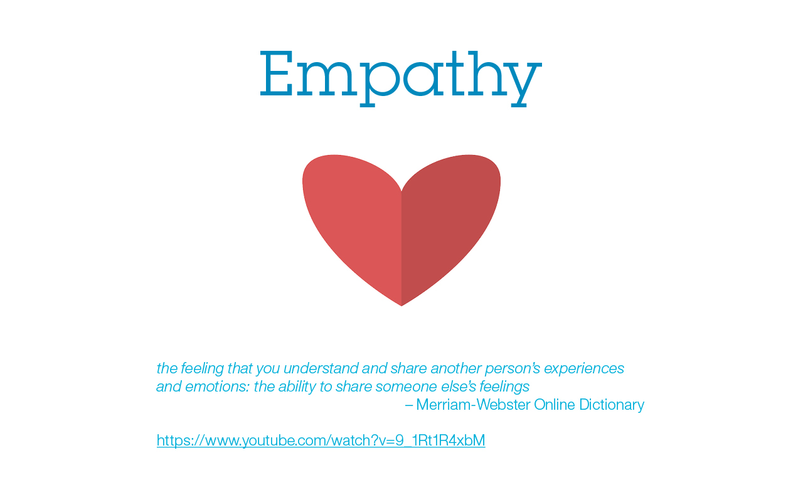
Build empathy with our user

Slide 4
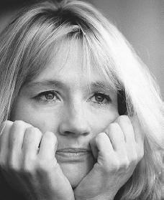
Meet our USER: JK Rowling

Slide 5
As a group please jot down notes on what you understand about your user and the space or situation that is going on.

Slide 6
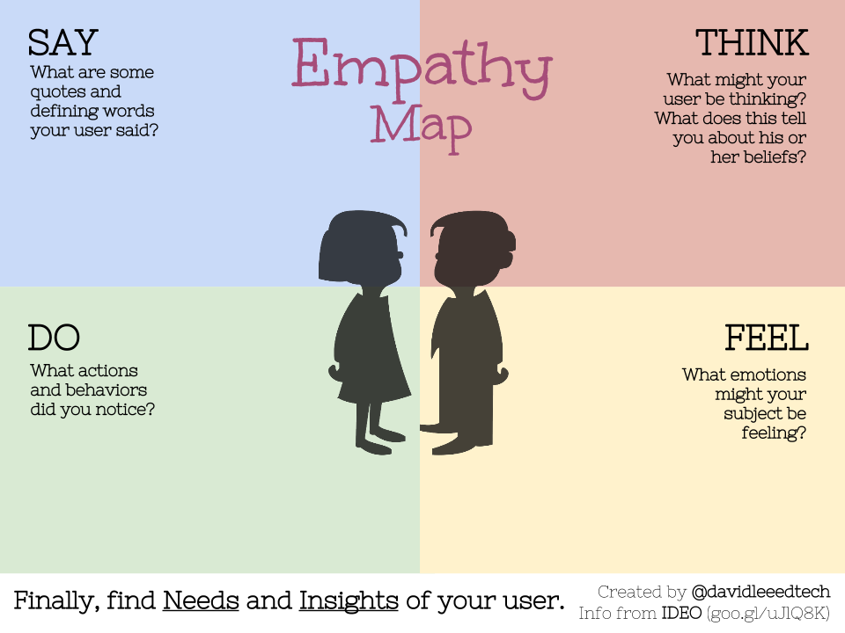
Empathy map

Slide 7
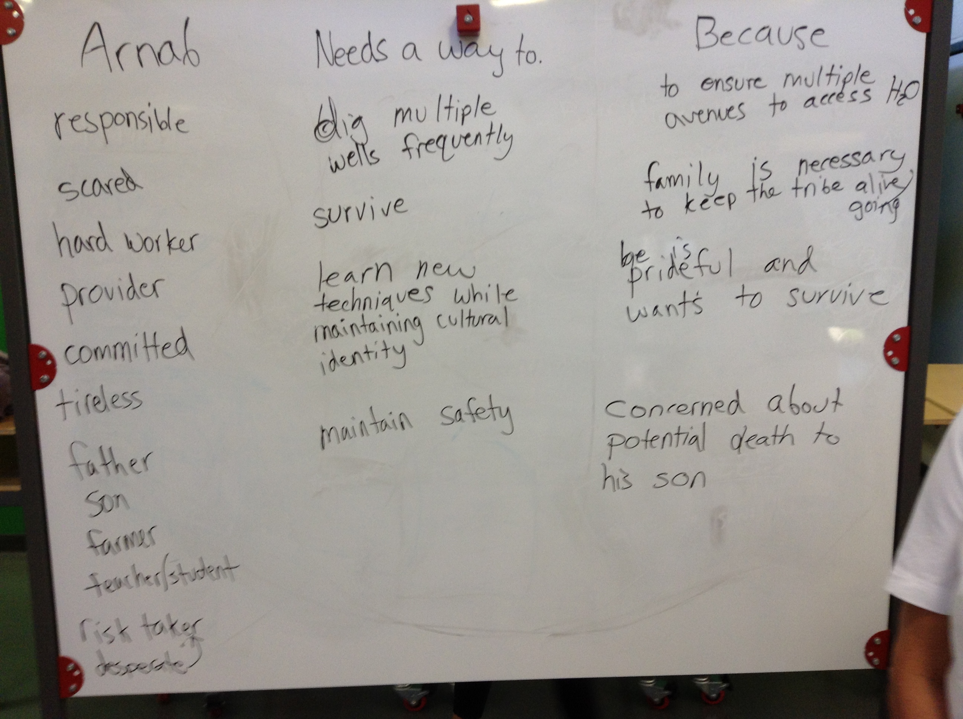
Needs chart

Slide 8
POV Statement

Slide 9
Rules for brainstorming
Do not judge ideas!
Go for wild ideas
Build on ideas of others
One conversation at a time
Capture all ideas
Use drawings and sketches
Come up with lots of ideas

