Slide 1
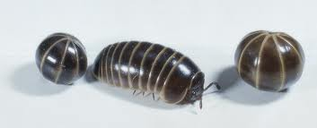
Classification Notes
pill bug
roly poly
wood louse
How can scientists study an animal that has at least three names?
They use classification and binomial nomenclature!
According to scientists, this is an Armadillidium vulgare.

Slide 2
Biologists use classification to organize living things into groups so that the organisms are easier to study.
CLASSIFICATION is the process of grouping things based on their similarities.
TAXONOMY is the study of how living things are classified. Taxonomy is useful because once an organism is classified, scientists know a lot about the organism.

Slide 3
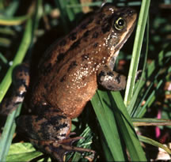
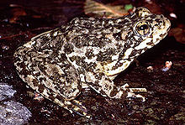
Carolus Linnaeus Swedish naturalist, 1750’s
Binomial Nomenclature
First name is Genus
Second name is Species
Ex: genus Rana has several different species of frogs.
Rana catesbiana
American bullfrog
Rana pretiosa
Oregon spotted frog
Rana muscosa
Mountain yellow-legged frog

Slide 4
In binomial nomenclature, which word is capitalized?
Only Genus (first name) is capitalized.
How is the name written?
In ITALICS when typed, underlined when hand-written.
Homo sapiens

Slide 5
Levels of Classification
The more classification levels that 2 organisms share, the more characteristics (or DNA) they have in common.
Scientists can classify organisms using DNA analysis which can more accurately show relationships among organisms.

Slide 6
Using DNA for Classification

