Slide 1


Slide 2
The Agenda…
Review Design Thinking Process
Define the problem space
Interview & empathize
Define needs
Ideate
Prototype, test, rework

Slide 3
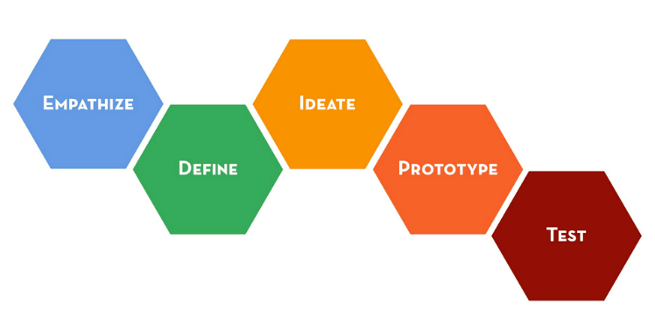
Stages of a Design Challenge

Slide 4

DESIGN THINKING: The Mindsets
Design Thinkers have empathy.
The process of solving problems is human-centered.

Slide 5
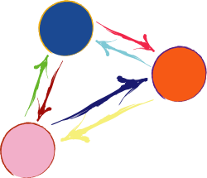
DESIGN THINKING: The Mindsets
Design Thinkers are radical collaborators.
Diverse Teams utilize their complex variety of
perspectives and skillsets to solve complex problems.

Slide 6
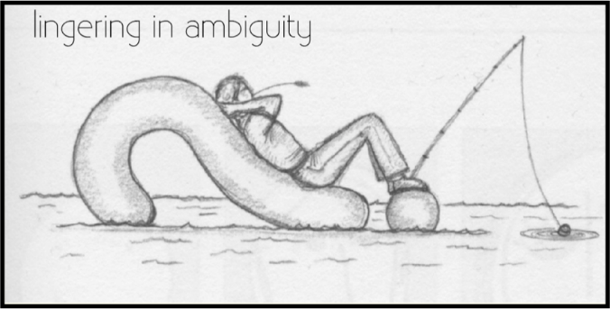
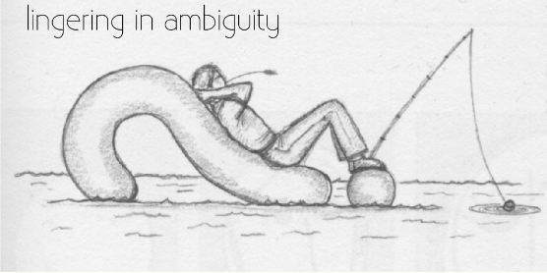
DESIGN THINKING: The Mindsets
Design Thinkers linger in ambiguity.
You gain the authority to propose a solution when
you have done the due diligence in understanding the problem.

Slide 7
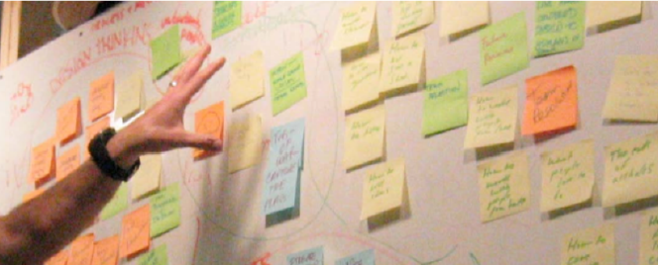
DESIGN THINKING: The Mindsets
Design Thinkers are SCARY when they brainstorm.
State, Create, Accept, React, Yes And….

Slide 8
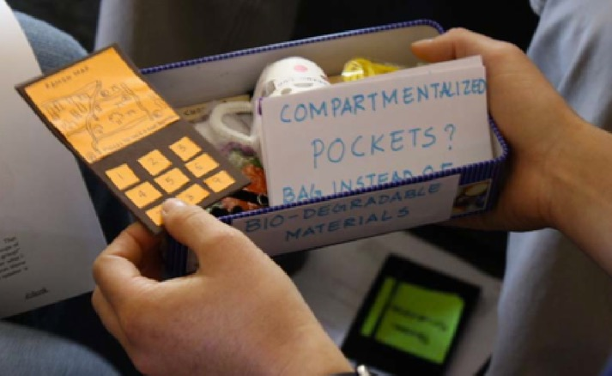
DESIGN THINKING: The Mindsets
Design Thinkers show; they don’t tell.
Your teams profound thoughts and insights, accumulated on the journey
through the once ambiguous problem space, are communicated
not with your words, but through your prototype.

Slide 9


DESIGN THINKING: The Mindsets
Design Thinkers embrace experimentation.
Don’t settle on one perfect solution. Try a few!
Exploration, examination and inquiry foster insights for innovation.

Slide 10



DESIGN THINKING: The Mindsets
Design Thinkers fail forward with a growth mindset.
Exercising a growth mindset means
assimilating feedback like a driver at a traffic signal
and reading each failure as a portion of the roadmap to success.
Notes:
Red= stop and think for a bit (not stop driving and abort the mission).
Yellow= slow down, you may need to stop and think.
Green= on the right track, keep going without hesitation in that same direction!

Slide 11

THE PROBLEM SPACE:
College Access

Slide 12
As you review the following data slides consider…
  What do you observe in the data?
  What surprises you in the data?
  What questions do the data invoke?

Slide 13
U.S. Education Rates

Slide 14
U.S. Degree-Attainment Rates

Slide 15
Utah Education Rates

Slide 16
Utah Degree-Attainment Rates

Slide 17
Utah vs. U.S. College Enrollment Rates

Slide 18
What the Data Say
38.7% of Americans age 25-64 have a 2 or 4 year college degree
Lumina Foundation Strategic Plan 2013-2016
65% of U.S. jobs will require some form of college education by 2020
Georgetown University Center on Education and the Workforce, 2012
Education is known to
  Improve health
  Lower crime rates
  And, yield citizens who are both globally aware and participate more in civic and democratic processes such as voting and volunteering
  College Board, Education Pays, 2011
First-generation students are less likely to attend college and are more likely to drop out prior to completion
First Generation Students in Postsecondary Education:
A Look at their College Transcripts, Xianglei Chen, National Center for Educational Statistics, 2005
54% percent of immigrants between the ages of 25 and 34 have completed high school or less as their highest level of education, compared to 36% for young adults whose parents were both born in the U.S.
U.S. Census Bureau, Current Population Survey, 2009.

Slide 19
What does this all mean to you?
Based on the discussion journal about your own experiences of applying to and attending college. Focus on the following guiding questions…
  What barriers, if any, did you face when applying to college?
  What feelings are evoked in relation to the application process?
  What was the one thing that pushed you to persevere in completing the process and being here today?
  Other thoughts and feelings?
Pair up and compare your experiences.
  Rank common experiences according to highest barrier to lowest and from highest support to lowest in the college application process

Slide 20
Now we know the problem, so what are we going to do with it?

Slide 21
EMPATHIZE:
Observing to Build Context

Slide 22
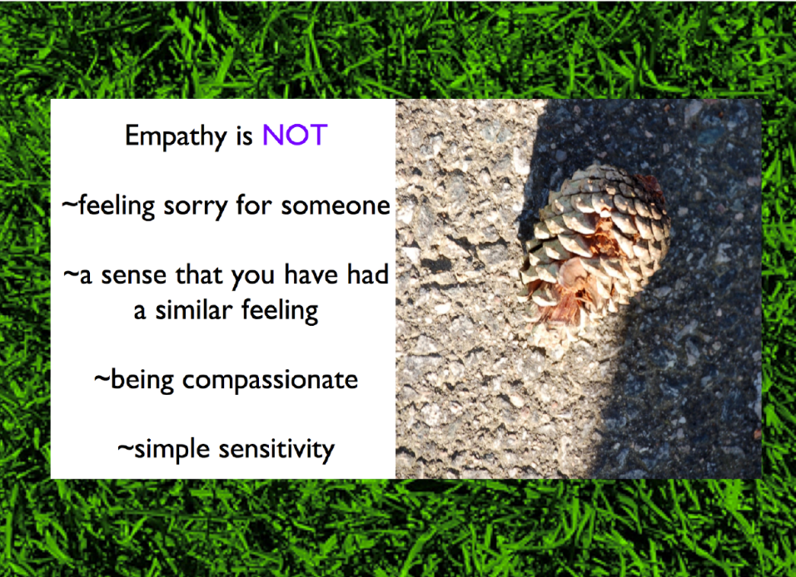

Slide 23
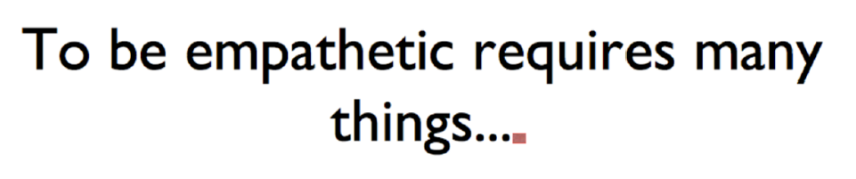

Slide 24
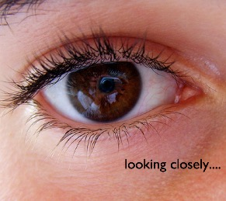
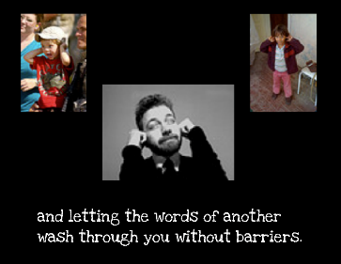
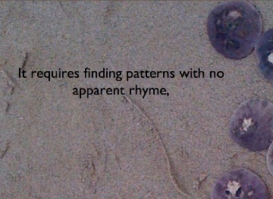
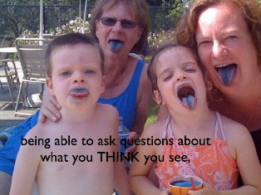
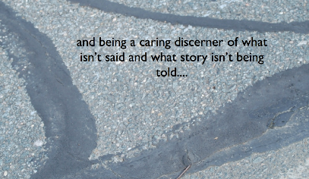
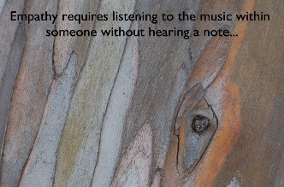


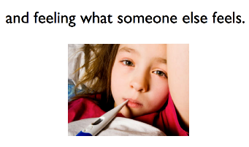

Slide 25


Slide 26
When Interviewing Consider…Who is this person and what affects them?
Building a GradNation Report 2014. (n.d.). Retrieved August 12, 2015.

Slide 27
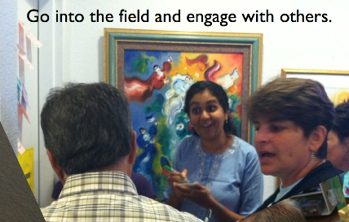
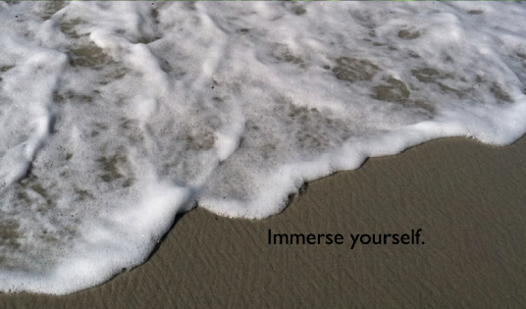
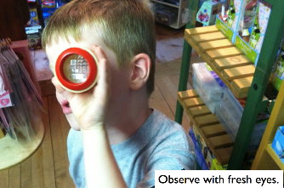
Don’t forget to…
And get to know your problem space!

Slide 28
EMPATHY:
Interviewing

Slide 29
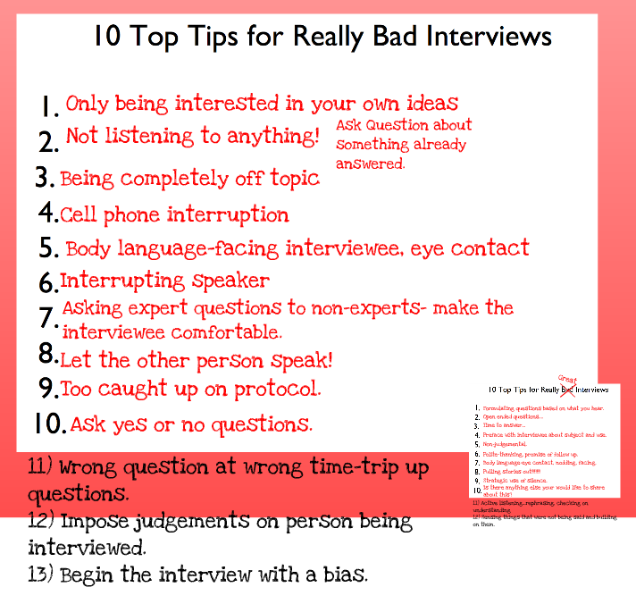
Interviewing: What we learned at orientation

Slide 30
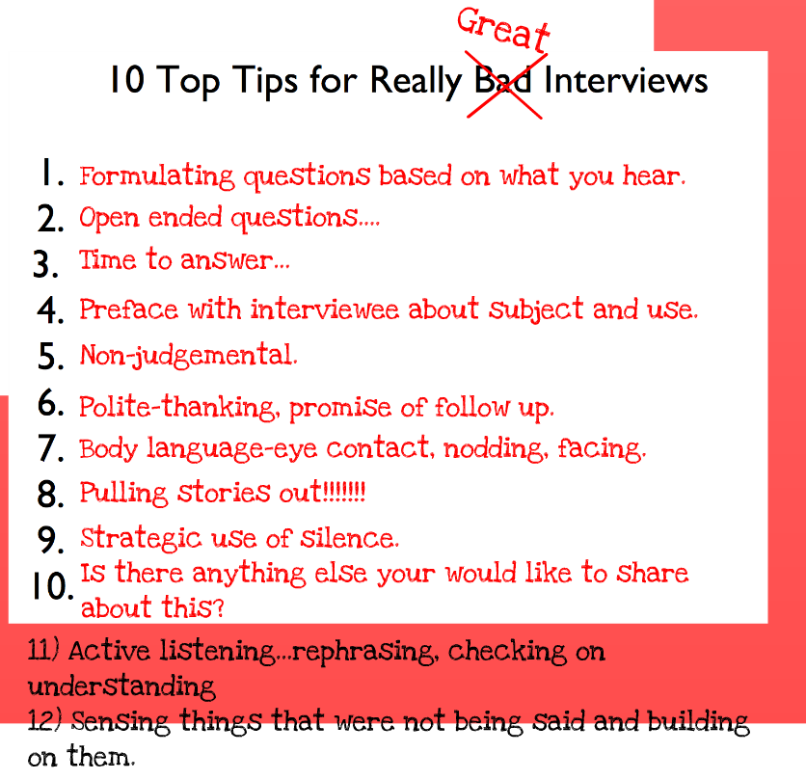
Interviewing: What we learned at orientation

Slide 31
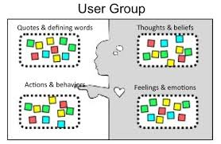
Empathy Map

Slide 32
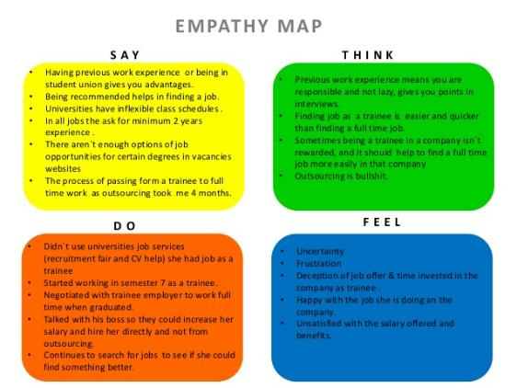
Example

Slide 33
Empathy Map
Complete your empathy map based on your group’s interview
Say | Think
Do | Feel

Slide 34

DEFINE:
Extrapolating Needs

Slide 35
DEFINE: Unpacking One Need
User’s Name (adjectives that describe user) | Needs a way to… (verbs to describe need) | Because… (insights from observations)
ex. Samuel, a curious 12th grader | ex. Needs a way to understand the financial aid process | ex. Because he needs financial assistance to attend college
Needs Statement:
Samuel, a curious 12th grader, needs a way to navigate the financial aid process because he needs financial assistance to afford the cost of college.

Slide 36
Now It’s Your turn…
User’s Name (adjectives that describe user) | Needs a way to… (verbs to describe need) | Because… (insights from observations)
Needs Statement #1:
Needs Statement #2:
Ask students to pair up and compare their experiences and rank their common experiences according to highest barrier to lowest and from highest support to lowest in the college application process.

Slide 37
DEFINE:
Check Your Work
Hidden Insights?
Uncovering the words left unsaid….
Verb to start the second blank?
No Implied Solution!
Deep Descriptions
?

Slide 38
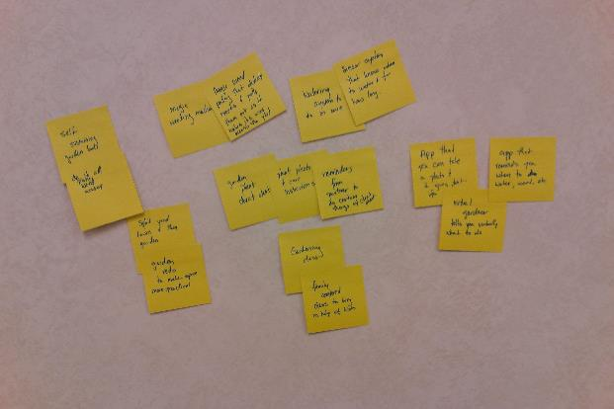
IDEATE

Slide 39
IDEATE:
Rules for Brainstorming
Hidden Insights?
Uncovering the words left unsaid….

Slide 40

Rule #1: Do not judge ideas!

Slide 41

Rule #2: Wild ideas!
“If at first an idea doesn’t sound absurd, then there’s no hope for it” Albert Einstein

Slide 42

Rule #3: Build on the ideas of others
Notes:
http://z.about.com/d/goindia/1/0/q/0/-/-/govinda.jpg

Slide 43

Rule #4: One conversation at a time
Notes:
http://aksjekonkurransen.files.wordpress.com/2008/08/trading-floor.jpg

Slide 44
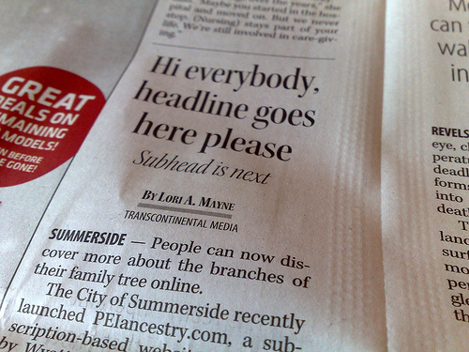
Rule #5: Be concise
Notes:
http://www.flickr.com/photos/reinvented/3150724610/

Slide 45
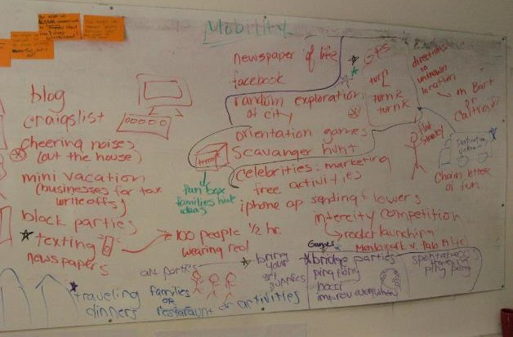
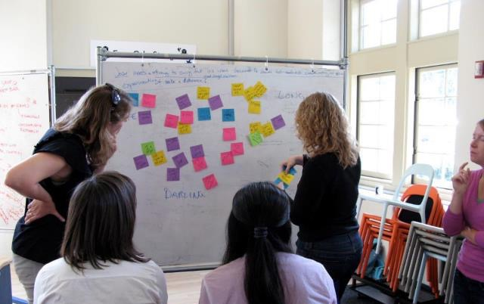
Rule #6: Capture all the ideas

Slide 46
Rule #7: Use drawings and sketches

Slide 47

Rule #8: Lots of ideas!

Slide 48




Paper based solutions
Million dollar solutions
IDEATE:
Brainstorm Solutions…
Technology based solutions
Social Relationships Solutions

Slide 49
Ready…Set…Go!

Slide 50
Checking Your Work
DEFINING with your NEEDS STATEMENT:
  Does the statement leave you open to many solutions?
  Does your description match your need?
  Did you capture the user’s underlying motivations?
  Does your second blank start with a verb? (____ needs a way to ____ )
IDEATION:
  Do you have solutions that don’t exist in the real world?
  Do you have solutions that MEET YOUR USERS NEEDS and MOTIVATION?

Slide 51

IDEATE: Selecting Your Solution

Slide 52
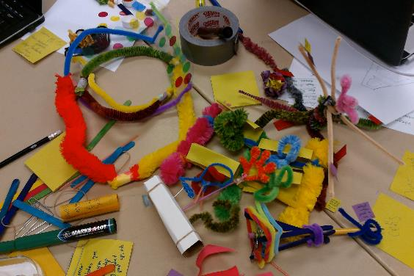
PROTOTYPE

Slide 53

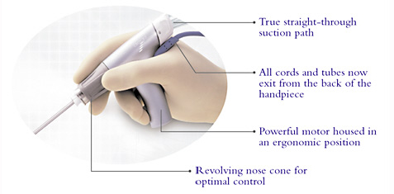
PROTOTYPE

Slide 54
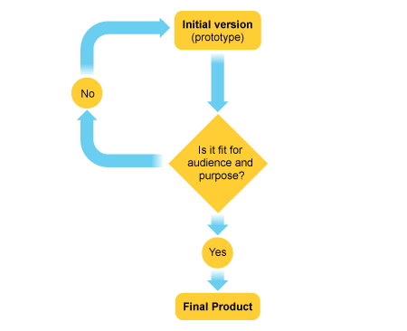
Test

Slide 55
Feedback Form
User:
What worked?
What didn’t work?
What of your needs did the prototype meet?
Is the prototype useful?
What would you change, if anything?
Other feedback?

Slide 56
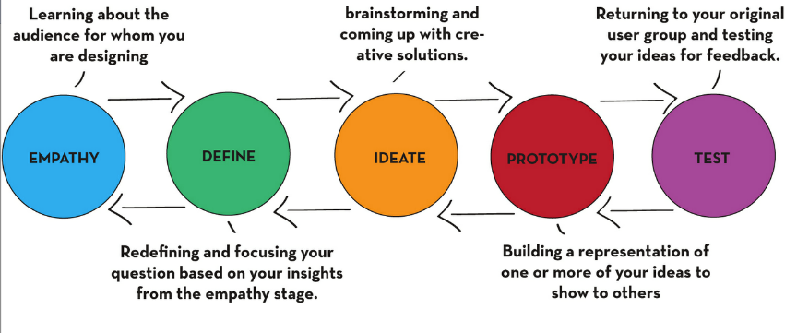
DESIGN THINKING: The Process

Slide 57

DESIGN THINKING
Final Thoughts:

